Slide 1









A Comprehensive Dashboard of Key HR Metrics and Performance Indicators
CASE STUDY
Client Challenge
Our Solution
Outcome
The client wanted to have an automated Human Resource Dashboard to track, analyze and report on HR KPIs.
The firm was looking for:
The company decided to use Infomineo’ Data Analytics service as a solution to cover:
The client benefited from Infomineo Data Analytics service on multiple fronts:
A stable and reliable data corrected in the ERPs :
Manual files were not used anymore
Data Quality improved by 75% for critical data elements
An organizational efficiency: 1 FTE from the HR department could be reallocated to other tasks
A company wide transformation: the client started its Data Transformation, and tasked Infomineo to work with the client’s Finance Team to create their Financial dashboard
Data Quality & Consistency problems between the various Data sources
Effective and quick solution
Smooth integration with its existing ERPs
Dashboard creation reflecting the HR Team’s needs
Lower cost than subscribing to a dedicated HR Dashboard tool
Ad-hoc deliverables :
Dictionaries, Creation of Metadata, Data Quality onboarding

Slide 2
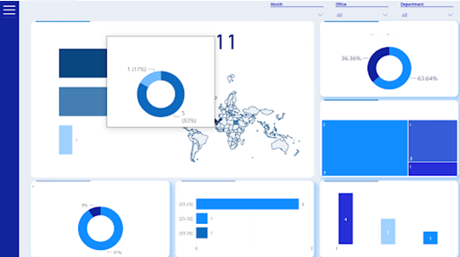
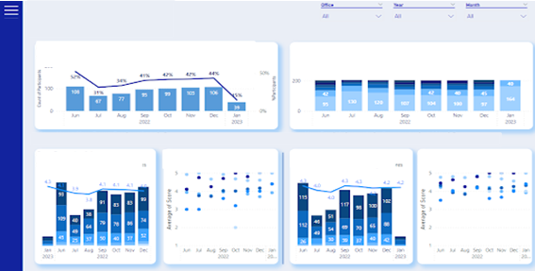
A Comprehensive Dashboard of Key Metrics and Performance Indicators
Achievements
A data model has been elaborated considering that 5 tools were identified to contain the Data source needed
14 source reports have been created and their extractions’ have been automatized using APIs
Data Quality Checks have been automatized given business rules
The Report created contained 3 main sections : Administrative, Professional Development, Recruitment
A full-fledged report with 30 Dashboards, 150+ graphs and 50+ KPIs

Slide 3
Assessing Candidates’ Experience through Sentiment Analysis
CASE STUDY
Client Challenge
Our Solution
Outcome
The client collects large amounts of candidates' feedback data during the recruitment process and was looking for ways to analyze the data received through a survey.
The firm was looking for:
Infomineo’ s Data Analytics team addressed the client’s challenges by:
The analysis provided the client with a comprehensive overview of candidate sentiments, enabling them to identify areas of strength and areas for improvement in the recruitment process.
In addition, the results of the analysis enabled the client to re-evaluate its recruitment procedures and make data-driven decisions to improve the candidate experience at the global, regional, country and departmental level.
The results also helped the client develop new perspectives on the power of AI-powered tools in streamlining and enhancing the analysis of large datasets
Conducting sentiment analysis using the state-of-the-art language model Roberta to analyze candidate feedback and extract the overall sentiment
Using AI-powered text summarization through Open AI's GPT-3 to extract key insights from candidate comments, focusing on areas of concern such as discrimination and unprofessionalism and showing the specific comments.
Automated tool to analyse candidate feedback as opposed to doing it manually
Generate relevant insights from the analysed data to improve the candidate recruitment experience
Creating a Dashboard :
Allowing for easy filtering of feedback and candidate sentiment

Slide 4
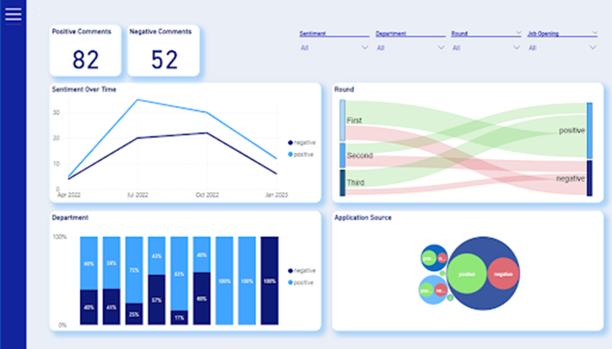
Assessing Candidate Experience through Sentiment Analysis
Distinguishing Positive and Negative Feedback from candidates’ comments
Leveraging pre-trained Roberta Model
Candidates’ feedback cleaning and pre-processing to ensure optimal input for the model.
Using "sentiment-Roberta-large model” as is for a start model.
Fine-tuning the model to client-needs
Identifying limitations in the pre-trained model’s
Manual labelling of a representative sample of candidates’ feedback data
Fine-tuning the model using the labeled data to better handle nuances and provide more accurate sentiment analysis results.
End to end solution deployed
Integrating the fine-tuned model with the ETL pipeline, automating sentiment analysis on incoming data
Dashboarding in Power BI for dynamic visualization of key insights, trends, and actionable feedback categories

Slide 5
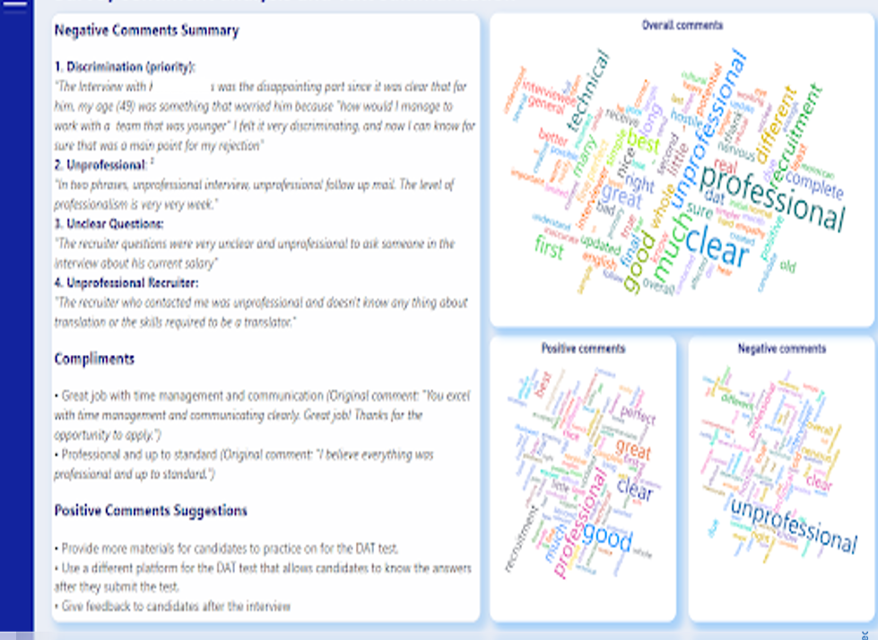
Assessing Candidate Experience through Sentiment Analysis
Highlighting Critical Insights: Advanced Text Summarization and GPT-3 Driven Categorization
Creating Embeddings for Candidate Comments
Tokenizing candidate comments custom NLP techniques and open-source tools
Generating high-dimensional vector representations (embeddings) for each comment via OpenAI's Embeddings API to enhance performance.
Exploiting OpenAI's GPT-3 API for Text Summarization
Utilizing GPT-3 model, to perform targeted text summarization
Providing the model with trained embeddings and specific summarization objectives for precise insight extraction
Prioritizing and Categorizing Comments
Instructing GPT-3 to prioritize comments related to topics specified by the client : Discrimination, Rudeness, Suggested Improvements
Applying custom filters and thresholds to fine-tune the categorization and selection of comments

Slide 6
Web Scraping Tool for Second-Hand Car Sales and
CASE STUDY
Client Challenge
Our Solution
Outcome
To analyze the secondhand automobile market in Morocco the client needed access to relevant and accurate data .
The client chose to use data of the country’s biggest C2C e-commerce platform.
Infomineo’ s Data Analytics team addressed the client’s need by:
A full-fledged webscraping tool, operable through a user interface was delivered to the client.
The solution enabled the client to extract listings from the e-commerce platform, across all cities and categories, using specific keywords.
The client gained time on the data collection process and created its own database of secondhand car sales.
Establishing data collection requirements
Developing a data collection plan
Designing a graphical user interface (GUI)
Cleaning and preprocessing the data
Allow an easy sharing of the code
The firm was looking for:
An efficient and consistent way to regularly collect data from an e-commerce website which operates in Morocco
Create a database with the data collected daily to avoid bias of unsold items

Slide 7
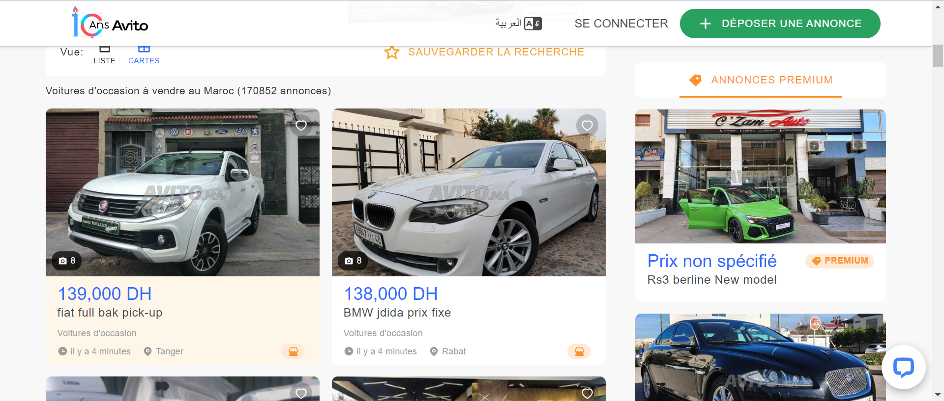
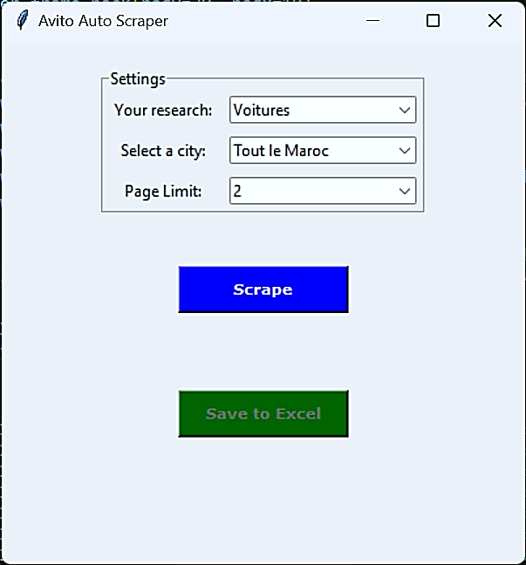
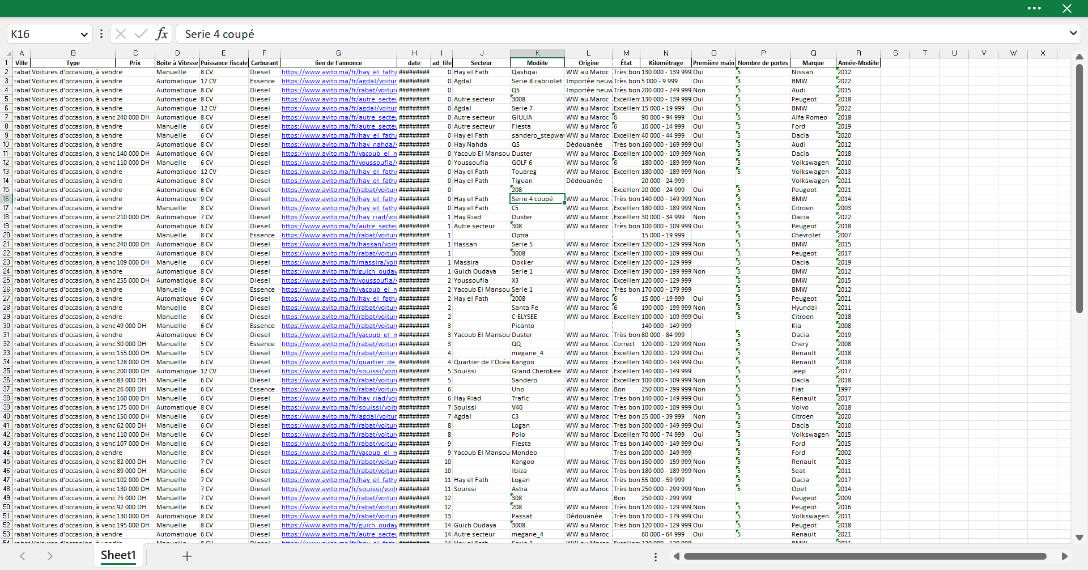
Web Scraping Tool for Second-Hand Car Sales
Establish data collection requirements
Determination of 15+ core data elements that allow the client to carry out its analysis : city, type, price, gearbox, fiscal horsepower, fuel, ad link, ad date, geographical sector, model, origin, condition, mileage, first-hand, number of doors, year-model.
Develop a data collection plan
Design a systematic plan to collect data from the chosen e-commerce platform using a home-made Web Scrapping Tool.
This plan allows systematic data collection and storage. Car's listings are pulled daily for the whole country to constitute this database.
Design a graphical user interface (GUI)
The GUI has been developed in order to allow the client to require specific car brands/models and collect data on demand.
Clean and preprocess the data:
Once the data is collected, clean and preprocess is used to ensure its quality and usability. This involve removing duplicates, correcting inconsistencies, and converting data formats.
Allow an easy share of the code
Adding the code in the official repository for Python packages

